Slide 1
Chapter 7: Molecules for living
Addition polymers

Slide 2
What is a polymer?
Polymers, or macromolecules, are large molecules consisting of a large number of smaller molecules (monomers) bonded together.
Synthetic polymers are man-made and are either:
Thermoplastic – soften on heating, easy to recycle, used in plastic bags, soft drink bottles and garden hoses.
Thermosetting – do not change shape when heated so are not recyclable. Are stronger than thermoplastic. Used in insulating foam, surfaces and electrical insulation.

Slide 3
The addition process
When a monomer contains a double bond, such as ethene, it can join to other monomers to create a long carbon chain without any loss of atoms.
This is an addition reaction and the polymer formed is called an addition polymer.
The properties of the final polymer depend on the structure of the monomer, including any side chains and its carbon chain length.

Slide 4
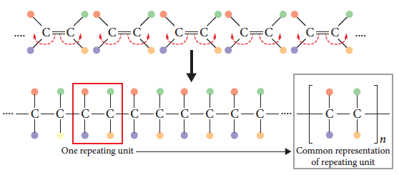
The addition process
A polymer consists of a number of monomers that can range from 100 to more than 100 000 units.

Slide 5
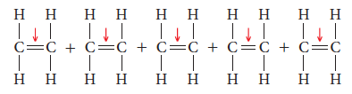
Ethene polymers – polyethylene
Ethene (or ethylene) molecules join to form a long chain polymer called polyethene. The preferred name for this polymer is polyethylene.
A catalyst is added to the ethene monomers causing the carbon–carbon double bond to break.

Slide 6
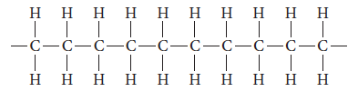
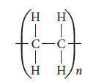
Ethene polymers – polyethylene
As each monomer now has free electrons, carbon–carbon bonds form between monomers, creating a long chain polymer.
A shorthand way of representing polyethylene is:
(n = number monomer units)

Slide 7
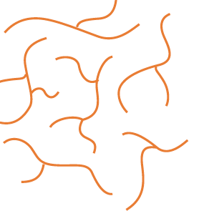
Ethene polymers – LDPE
Produced using high temperature and pressure and an initiator to start the reaction.
A branched structure forms that does not allow for close packing due to the branches. This is Low Density PolyEthylene (LDPE).
This is a flexible polymer with a
low melting point and low density.

Slide 8
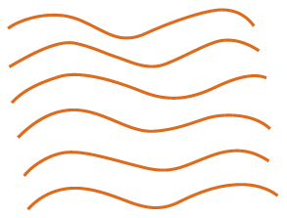
Ethene polymers - HDPE
High Density PolyEthylene (HDPE) is produced using the Ziegler–Natta process. This requires lower pressures and temperatures and a catalyst, Titanium based.
An unbranched polymer forms that is higher density with a higher melting point. It is also less flexible.
Notes:
Experiment 7.1 – Investigating crystalline and amorphous packing of polymer chains.

Slide 9
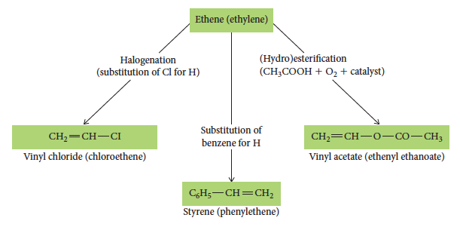
Other polymers
Ethene can also be used to create other monomers that form polymers, such as polystyrene and PVC.

Slide 10

PVC
PVC or polyvinylchloride is made from the vinyl chloride monomer:
The polymer produced is amorphous (does not pack well) due to the chlorine atoms off the main chain.
PVC is a hard, non-flexible polymer used for pipes. To make it more flexible, a plasticiser is added that pushes the chains apart and reduces bonding between chains.
Notes:
Alternately the textbook has similar information on Polystyrene and Polypropylene
Table C7.2 provides comparison information on a range of addition polymers.

Slide 11
Copolymers
If more than one type of monomer is used in the addition process, the properties of the final polymer can be controlled/designed.
A copolymer has a polymer structure formed from more than one type of monomer.
The copolymer formed has properties different from that of the polymer composed of only one of the constituent monomers.

Slide 12
Chapter 7: Molecules for living
Properties, uses and structures

Slide 13
Introduction
Polymers can be synthesised or chosen to have particular properties.
Structural features such as level of branching, the amount and type of cross links and the presence of particular side groups can influence properties including melting point and flexibility.
Structure determines function.

Slide 14
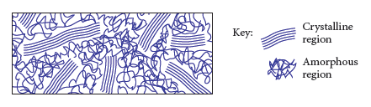
Crystallinity
As polymer chains form, they can wrap around each other causing areas of order (crystalline region) and disorder (amorphous region).

Slide 15
Crystallinity
Highly crystalline polymers pack more closely than amorphous polymers, so have a higher density.
Their intermolecular bonding is stronger than amorphous polymers, so they have higher melting points and are stronger and more rigid.
Crystalline polymers are also more opaque and the close packing does not allow entry of air, water or chemicals, so they are more resistant to chemicals.

Slide 16
Crystallinity
This is the ordered alignment of molecules and is the major influence of a plastics toughness and strength.
Polyester fibres such as PET are resistant to creasing and wrinkling and so 60% of fibre production is made from PET.
PET polyethylene terephthalate.

Slide 17
Branching
Highly branched chains cannot pack as closely as unbranched polymers.
Unbranched polymers are denser (more closely packed), more crystalline, less transparent and less flexible.
To make a branched polymer with alternate properties requires extreme reaction conditions in order to break carbon–carbon bonds.

Slide 18
Chain length
Chain length affects the production of the polymer. In the production process, chains of different lengths are produced.
Long chain polymers have more intermolecular forces between chains so have higher melting points and are harder substances.

Slide 19
Side groups
The side groups that are attached to the main chain can change properties of the polymer.
A larger side group can change the flexibility of the polymer, making it more rigid.
Replacing atoms, for example replacing a hydrogen with a chlorine, stiffens the polymer.

Slide 20
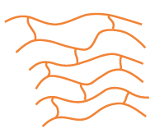

Cross-linking
Cross-linking involves joining linear polymer chains through ionic or covalent bonds between the chains.
These are strong bonds and increase the hardness and rigidity of the polymer
in a 2D and 3D structure.
Notes:
Experiment 7.2 – Making a cross-linked polymer – making a polymer from borax and PVA glue.

Slide 21
Stability/biodegradability
The bonds between most atoms in a polymer are covalent, so are quite difficult to break.
This means they are not biodegradable because they do not break down easily over time.
To increase biodegradability, copolymers are created with natural monomers, such as glucose, that break down in nature, so the polymer will break down when thrown out.
Notes:
Investigation 7.1 – Identifying platsics by their density.

Slide 22
Chapter 7: Molecules for living
Condensation polymers

Slide 23
What is a condensation polymer?
A condensation polymer forms through a condensation reaction between a carboxylic acid and either an alcohol or an amine.
This forms either an ester or amide group that becomes part of the main polymer chain.
The monomers must therefore have these functional groups.

Slide 24
Polyesters – preparation
A polyester forms when a monomer with a hydroxyl group reacts with a monomer with a carboxylic acid group.
A molecule of water is eliminated for every bond that forms between monomers.
Many ester links form within the chain, hence a polyester.

Slide 25
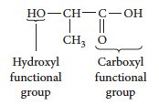
PLA – a single monomer example
PLA or polylactic acid is prepared using a single monomer.
It has one of each of the required functional groups in the same monomer. The monomers line up so the hydroxyl group is next to the acid group and a reaction can occur.

Slide 26
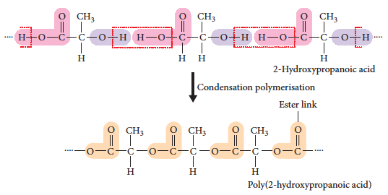
Polyesters – preparation

Slide 27
Single and double monomers
When preparing a polyester the monomers can have various configurations.
Option 1: a single monomer is used – it has a hydroxyl group at one end and a carboxylic acid at the other end.
Option 2: two different monomers are used – one is a diol (two hydroxyl groups, one at each end) and the other is a dicarboxylic acid.

Slide 28
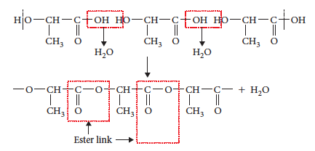
PLA – a single monomer example

Slide 29

PET – double monomer example
PET, or polyethylene terephthalate, is used in clothing, bottles and a wide range of plastics.
Two monomers are used to make PET, one a diol (ethylene glycol), the other a dicarboxylic acid (terephthalic acid).

Slide 30
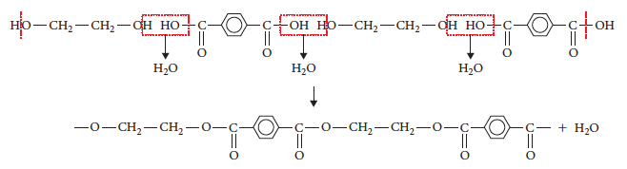
PET – double monomer example

Slide 31
Polyamides – preparation
Reaction between a monomer with an amine group and a monomer with a carboxylic acid group forms a condensation polymer called a polyamide.
Again, a single monomer with both functional groups can be used. Alternatively, two monomers, one diamine and one dicarboxylic acid can be used.

Slide 32

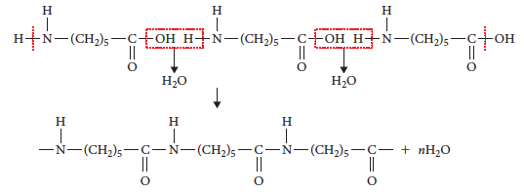
Polyamide – single monomer – nylon-6
Use of a single monomer:

Slide 33

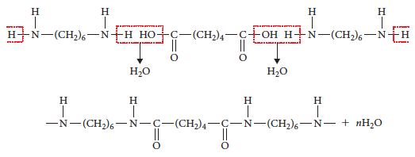
Polyamide – double monomer – nylon-6-6

Slide 34
Chapter 7: Molecules for living
Carbohydrates

Slide 35
What is a carbohydrate?
Carbohydrates include simple sugars, such as glucose and sucrose, and natural polymers, such as cellulose or starch.
The properties of carbohydrates depend on their structure.
Glucose, sucrose, cellulose and starch all contain glucose molecules, but the different arrangement gives very different properties.

Slide 36
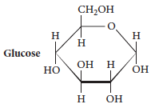
Structure
All carbohydrates contain carbon, hydrogen and oxygen. The carbon atoms are arranged in a ring structure, usually containing 4 to 6 carbons.
The carbons are bonded to OH groups and H atoms. Larger molecules contain multiple rings bonded together.

Slide 37
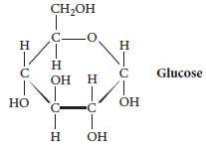
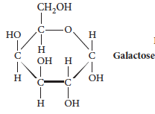
Monosaccharides
Monosaccharides have a single ring structure and commonly have the formula C₆H₁₂O₆.
They include glucose, fructose and galactose.

Slide 38
Monosaccharides
The positioning of the OH groups differentiates the two structures.
On the carbon on the left side, the OH group is below the carbon for glucose, but above the carbon for galactose.
This gives them different properties.

Slide 39
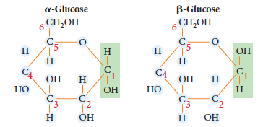
Monosaccharides
Glucose has two isomers, called α-glucose and β-glucose (alpha and beta glucose) that vary in the placement of the OH group on the C₁ carbon.

Slide 40
Disaccharides
Joining two monosaccharide ring structures forms a disaccharide, a double ring structure, joined by a glycosidic link: –C–O–C–.
This is a condensation reaction as a molecule of water is eliminated during the reaction.
Formation of sucrose from two glucose molecules:

Slide 41
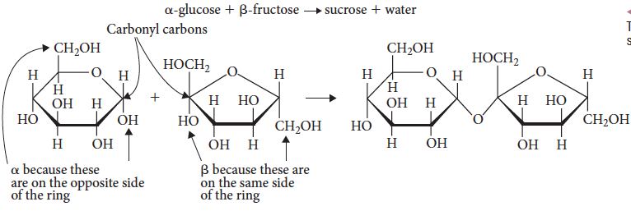
Disaccharides
As monosaccharides, especially glucose, can have isomers and placings of the OH groups, the joining of these structures is more complex.
Notes:
Experiment 7.3 – Analysing sugar in soft drinks.

Slide 42
Disaccharides
When two glucose molecules join, maltose forms. When a glucose and galactose molecule join, lactose is formed.
The different disaccharides have different properties, depending on how the monosaccharides join together.
For example, sucrose and fructose are sweet, while maltose and galactose are not.
Notes:
Experiment 7.3 – Analysing sugar in soft drinks.

Slide 43
Polysaccharides
Polysaccharides consist of many monosaccharide monomers (e.g. glucose) joined together with glycosidic links.
The polysaccharide can have only one type of monomer or a number of different types.
The resulting polysaccharide can be branched or unbranched, giving very different properties.
Cellulose and lignin(wood) complex natural polymers.

Slide 44
Polysaccharide secondary structures
Bonding between the polysaccharide chains leads to formation of helical and sheet structures.
In general these are stable because of the large number of bonds that form, but are easily disrupted if the pH, temperature or certain chemicals are added.
Cross-links are present in polysaccharides like cellulose that give it strength and rigidity. A highly branched polysaccharide such as glycogen does not form cross-links, so lacks these properties.

Slide 45
Chapter 7: Molecules for living
Proteins

Slide 46
What is a protein?
Proteins are polymers containing amino acid monomers joined together in a condensation reaction to form a polyamide.
The polyamide chain is folded into specific shapes to make proteins that carry out a multitude of jobs including structural support, hormones, enzymes, and balancing chemicals in the body.

Slide 47
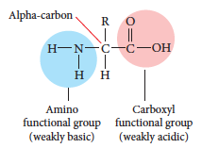
Amino acids
There are 20 naturally occurring amino acids that all have the same basic structure.:
The R group varies between amino acids and may be polar or non-polar. It may contain functional groups and it may be able to form ions.

Slide 48
Primary structure
Joining amino acids is done by an amide condensation reaction to create a polyamide chain, the primary structure.
The most important aspect is the ordering(sequencing) of the amino acids. The order in which they are assembled determines the final structure and hence function of the protein.
Structure and function in proteins are heavily linked. Structure determines function.

Slide 49
Joining amino acids
The link between amino acids is called a peptide link and is the same as an amide link in a polyamide. These are made from a carboxylic acid and amine group joining by condensation.
Two amino acids joined together create a dipeptide.
When many amino acids join together, a polypeptide chain is formed.

Slide 50
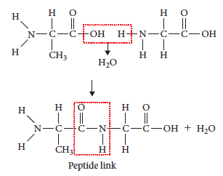
Joining amino acids
To join two amino acids, react the amine end with the carboxylic acid end to form the peptide link.

Slide 51
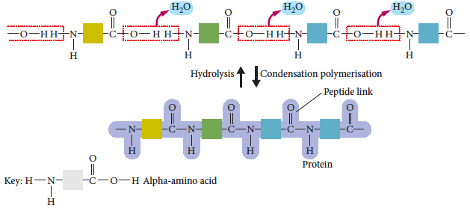
Joining amino acids
The dipeptide continues to join to other amino acids via the functional groups at either end of the molecule.

Slide 52
Secondary structure
When the primary polypeptide chain is complete, it will form secondary interactions with other chains, or itself, by folding and twisting.
An alpha helix forms when the C=O part of one amino acid forms a hydrogen bond to the N–H section on a different amino acid, causing the structure to form a spiral shape.
A beta sheet forms when different chains form hydrogen bonds between them, when side chains are small.

Slide 53
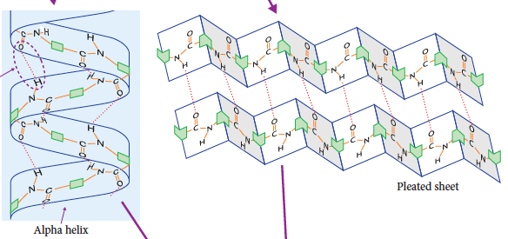
Secondary structure
Primary chain forms one of two secondary structures.

Slide 54
Tertiary structure
The secondary helices and sheets fold into particular shapes to form a tertiary structure.
The protein is held together by interactions of the R groups. Various strength bonds can form, including dispersion forces, dipole-dipole/hydrogen bonding and ionic bonds.
A disulfide bridge occurs within the cysteine amino acid and two –SH align and lose the hydrogens to form a covalent S-S disulfide bridge.
In some proteins, multiple tertiary structures bond together to form a quaternary structure.

Slide 55
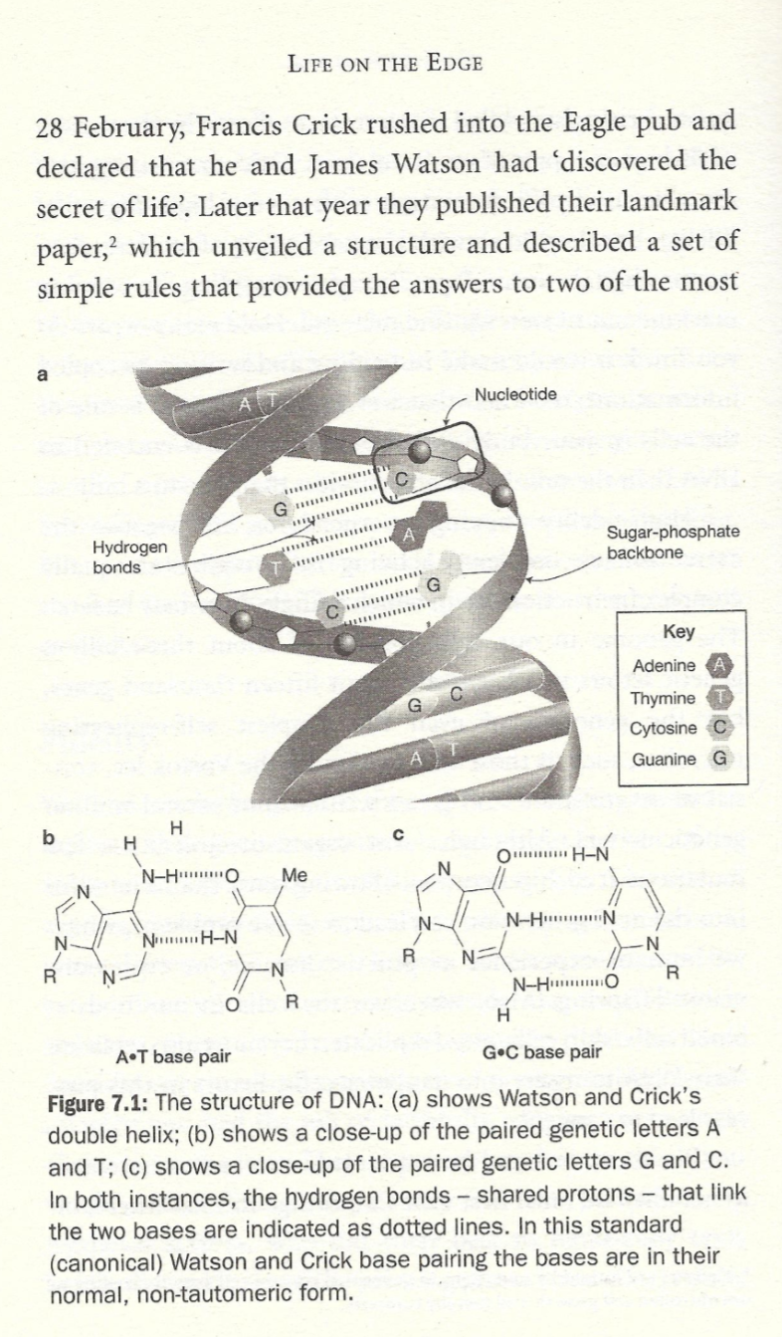
H bonding, 1953

Slide 56
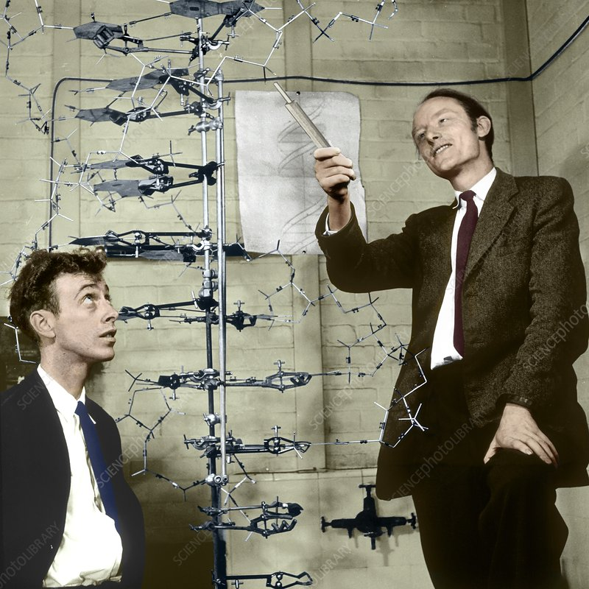
DNA double helix

Slide 57
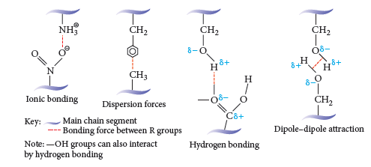
Final structure
Examples of the bonds between R groups:

Slide 58
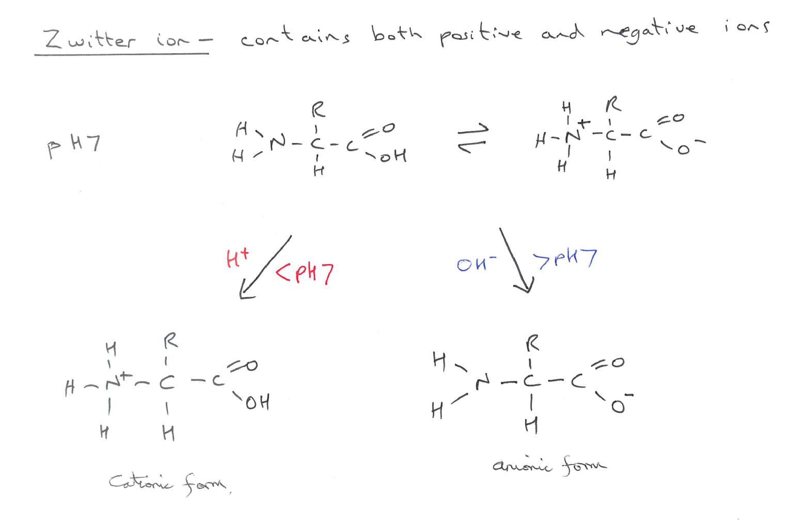
Zwitter ion

